Slide 1

Compiler Project Mini C++ compiler
Submitted by : Vikhyat Tandon IIT2011203
Ankit Jat IIT2011205
Atul Sakhala IIT2011206
Atul Vaibhav IIT2011208
Vikash Sandhu IIT2011209
Shubham Mishra IIT2011211

Slide 2
Problem statement
Construct a mini C++ type compiler.
It should be able to strictly identify only C++ code.
It should report an error And any C code which is acceptable in C++.

Slide 3
Introduction
The C and C++ programming languages are closely related. C++ grew out of C, as it was designed to be source-and-link compatible with C. C++ was based on C and retains a great deal of the functionality. The C++ language provides mechanisms for mixing code that is compiled by compatible C and C++ compilers in the same program. As a matter of fact, C++ can run most of C code while C cannot run most C++ code.
The purpose of compatibility with C is so that C++ programs can have convenient access to the billions (trillions?) of lines of existing C code in the world.

Slide 4
We aim at detecting such snippets of code in our input program and will give an error if a incompatible code is detected, whilst if no incompatible code could be detected then we will compile, i.e. a mini compiler for C++.

Slide 5
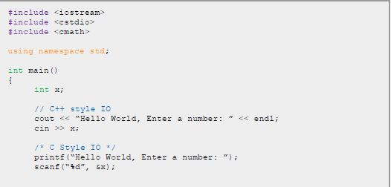

An example of C code valid in C++ code:

Slide 6
In addition to detect C code inside C++ code, our Mini C++ compiler will also be able to report following errors to the user:
Invalid variable name.
Invalid basic arithmetic expression.
Syntax error in While loop.
Syntax errors in For loop.
Syntax errors in If-Then-Else.

Slide 7
Tools used
We have used following two tools to implement our project:
YACC - produces a parser
LEX - generates lexical analyzers
GCC – gnu C Compiler
G++ - gnu C++ Compiler

Slide 8
Methodology or
The project is implemented in the following steps: -
Read the given Input.
Tokenize the input using Lex rules.
Parse using Yacc rules.
Run the Algorithm described below.

Slide 9
Algorithm
Goal: detect a c code that is generally successfully compiled by a C++ compiler and accept small C++ codes.
Steps:
1. Detect for header files (generally all c codes have .h header files)
2. Detect C language functions and keywords that are compatible with C++ compilers.

Slide 10
Algorithm
3. If( c code detected )
Then return ERROR and STOP.
Else goto step 4.
Check for error like
Invalid variable name.
Invalid basic arithmetic expression.
Syntax error in While loop.
Syntax errors in For loop.
Syntax errors in If-Then-Else.

Slide 11
Work done so Far
1. Did the required literature survey.
2. Design our Algorithm
3. Completely run by using CD drive.
4. Project report 1 created.
5. Implemented the mini compiler for C++.
6. Completed the project with results verified with test files.

Slide 12
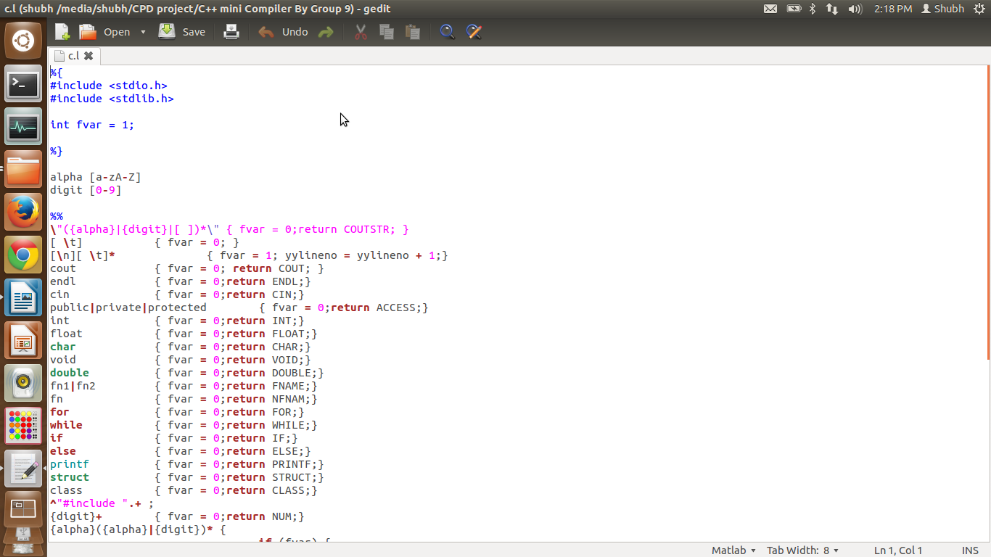
Snapshot of the Lex File Snap

Slide 13
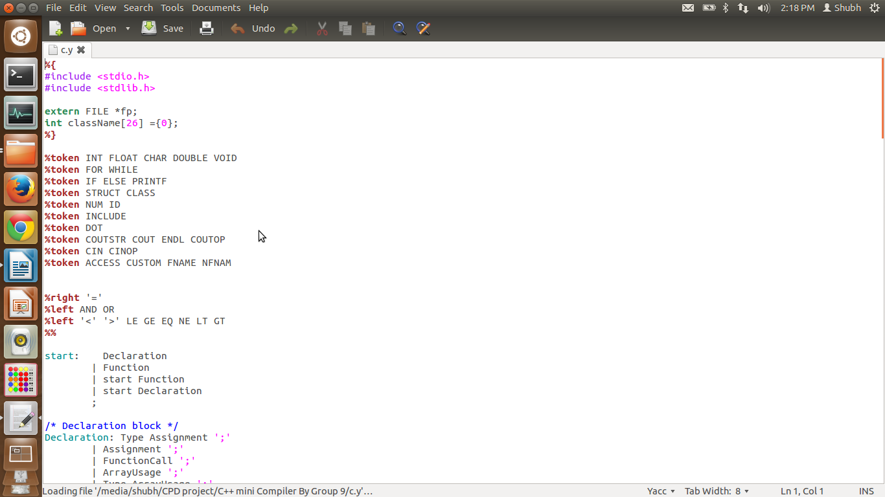
Snapshot of the yacc File Snap

Slide 14
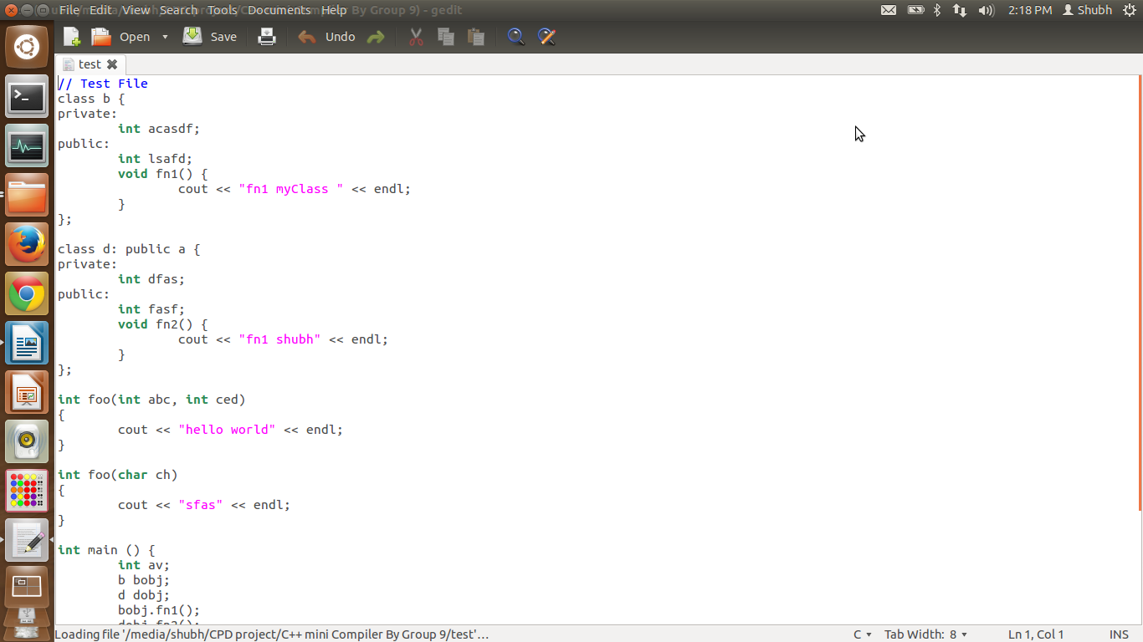
Test File For Polymorphism:- Test File for error

Slide 15
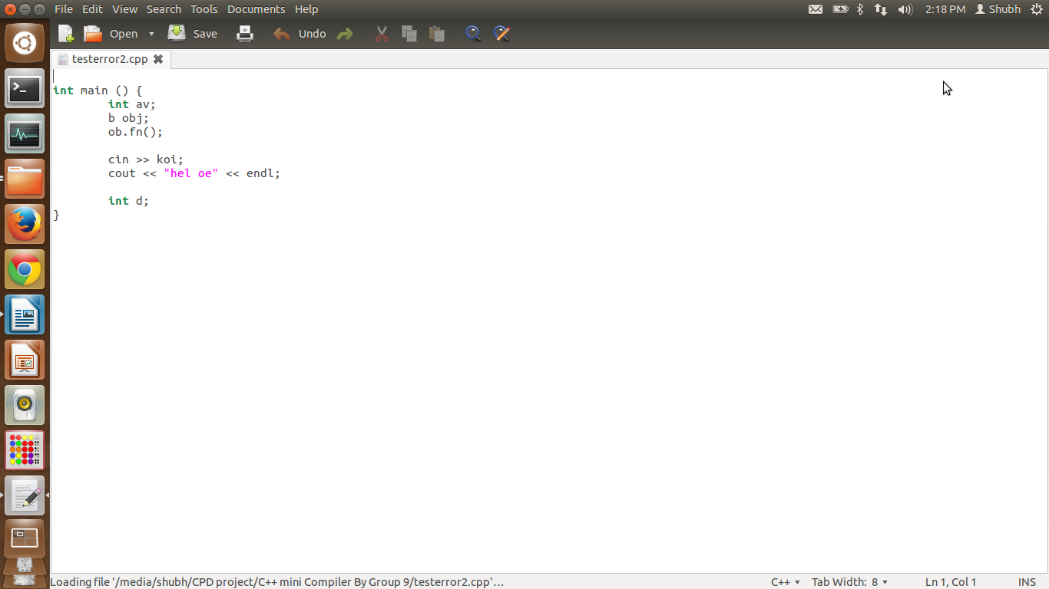

Slide 16
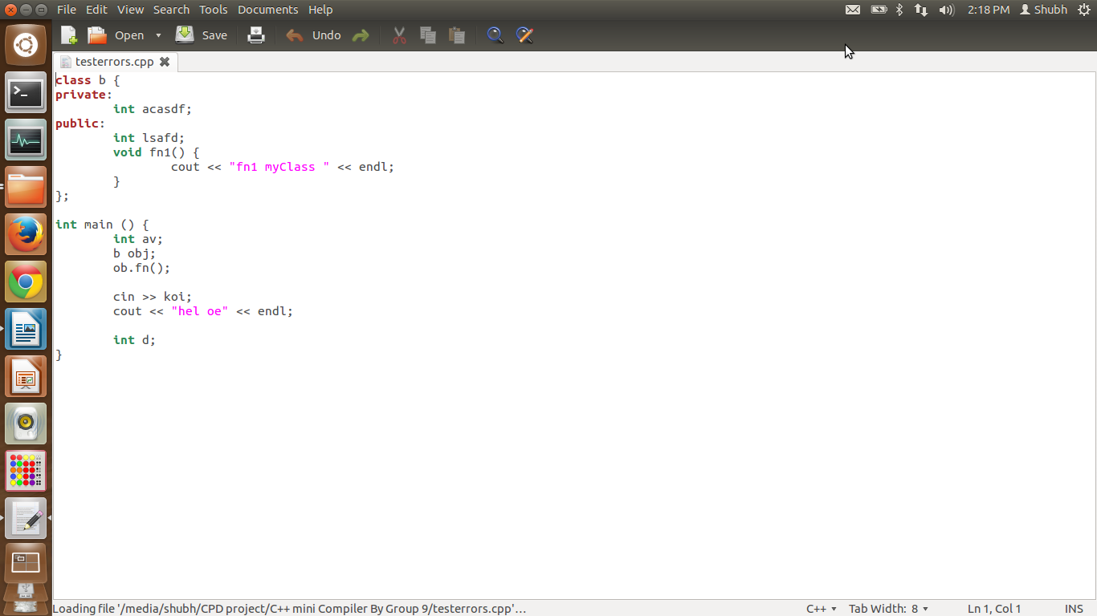
Test file for error

Slide 17
Thank You!

